Slide 1
Welcome to English
With Ms. Lerma
and Ms. Carlos
What you need to know about our class:
Background of the teachers
Communication
Syllabus

Slide 2
Education- Ms. Lerma
Chino Valley Unified School District - High School Diploma
Mt. San Antonio College – Associates Degree U. C. Riverside – B. A in English/Teaching Credential University of San Diego – M. Ed in Special Education

Slide 3
Education- Ms. Carlos
Chino High School - High School Diploma
CalPoly Pomona – B. A in English/Multicultural Studies
Teaching Credential
M. Ed in Special Education
Preliminary Admin. Credential

Slide 4
Google Classroom:
Communication
Classlink to Google Classroom
Breanne_Lerma@chino.k12.ca.us
Clarita_Carlos@chino.k12.ca.us

Slide 5
Materials Needed
Textbook (online only or print with request)
Chromebook (with camera access)
Paper
Pencils/Pens
Highlighters

Slide 6
GRADES
Writing (35%) - Bell ringers, essays, written assignments, etc.
Speaking and Listening (30%) - Speeches, discussions, presentations, etc.
Reading (35%) - Bell ringers, reading comprehension assignments, etc.

Slide 7
GRADING BREAKDOWN
A+ | 97 - 100% | C+ | 77 - 79.9%
A | 93 - 96.9 % | C | 73 - 76.9 %
A- | 90 - 92.9% | C- | 70 - 72.9%
B+ | 87- 89.9% | D+ | 67 - 69.9%
B | 83 - 86.9% | D | 60 - 66.9%
B- | 80 - 82.9% | F | 59.9 % and below

Slide 8
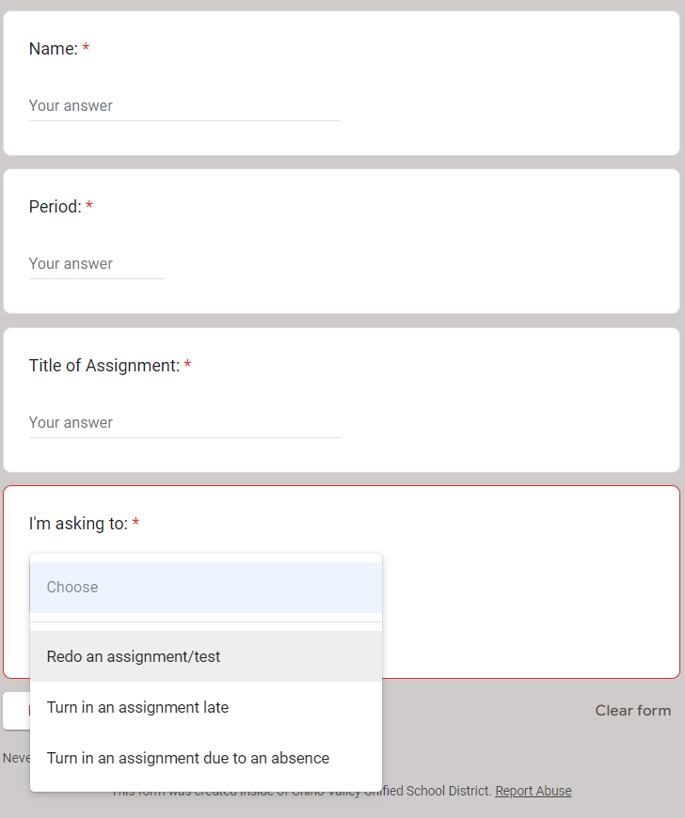
Late Assignment Policy
Assignments are due at the time and date posted unless an excusable reason has been provided to the attendance office.
Late work will not be accepted if it is over 3 weeks old.
Late work will be graded when we are able to grade it.
Student must submit the assignments on Google Classroom under the late work assignment post.
Late work will be penalized by 10% for every day passed the due date up to 50%.

Slide 9
BEHAVIOR EXPECTATIONS
Be in your seat and ready to start class when the bell rings.
Remain in your seat unless otherwise instructed.
Listen attentively to others when they speak.
Show respect for the opinions and ideas of others.
Finish classroom assignments in the time provided.
Bring all necessary materials to class, have Chromebooks charged and come prepared to learn.
Violations of these expectations may result in the following:
Teacher assigned detention.
Counselor conference.
A phone call home.
Removal from course.

Slide 10
RESTROOM AND CELL PHONE/HEADPHONE POLICY
Students must ASK to use the restroom. Only one at a time is permitted.
Students must create a SmartPass and take a HALL PASS to the restroom.
Must be back within 6 minutes.
Cell phones and headphones are not to be used while teachers are actively engaging with students.

Slide 11
Academic Honesty and AI
Students are encouraged to be engaged participants in their educational journey. While Artificial Intelligence serves as a valuable tool to enhance the learning experience, it should complement rather than replace active learning and comprehension of the material. Ms. Lerma and Ms. Carlos will offer students opportunities to utilize both traditional writing methods and AI resources effectively. Students who utilize AI-generated content or any external work not belonging to them without proper authorization from their teachers will be given a zero for the respective assignment.

Slide 12
The English Curriculum
ELA 11 is closely related to US History. Some of the class will cover similar topics, however, ELA 11 focuses on the literary aspect of US History.

Slide 13
Success is Attainable
We have sat in desks very much like the ones you will be in when we return to school. We have struggled with new concepts and have worked hard to improve our understanding. You are all capable of the same. Good luck on a new school year!

